Slide 1
PIZZA ORDERING SYSTEM
WEB APPLICATION

Slide 2
TEAM MEMBERS
VIDHI SHARMA
SATYAM GUBRELE
RASHI RUHELA
PROJECT SUPERVISOR:
DR.(PROF.) VIPIN KUMAR

Slide 3
INTRODUCTION
The Pizza Ordering System is a Web-based application that enables customers to order their pizzas online. This system enables a user to choose from a variety of pizza types, the size of pizza, toppings and extra items.
This website provides an efficient and reliable system.
It highlights its user-friendly interface, customizable menu-options and online ordering.
Every organization, whether big or small, has challenges to overcome and managing the information of online order, pizza, payment. This system will ultimately allow you to better manage resources.

Slide 4
MODULES DESCRIPTION
The Pizza Ordering System consists of 6 modules:
1. User Module: User module provide accessibility to user so they can manage their profile and use other modules.

Slide 5
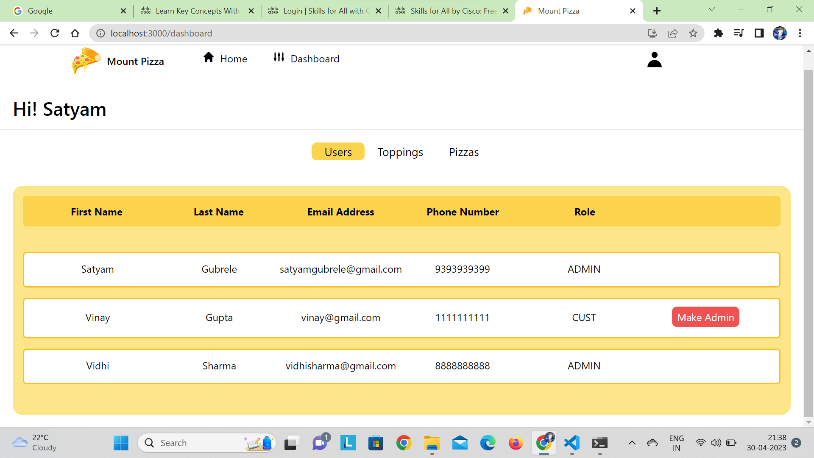

Slide 6
2. Login/Sign-Up:
The user who is already registered can login to system by using their login id and password.
The user who is not registered can create his or her account , option of sign-up is available.

Slide 7
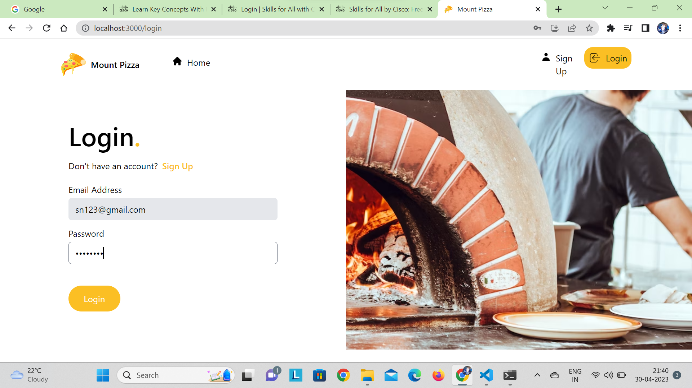

Slide 8
3. Add To Cart:
This feature is useful in a situation where you have to order more than one pizza. Suppose you have selected a Margherita pizza and now you want to select another pizza as well, then you just have to add that pizza to the cart using the Add to cart option.
Items added to the cart will be saved so that you can choose other pizzas as well.

Slide 9
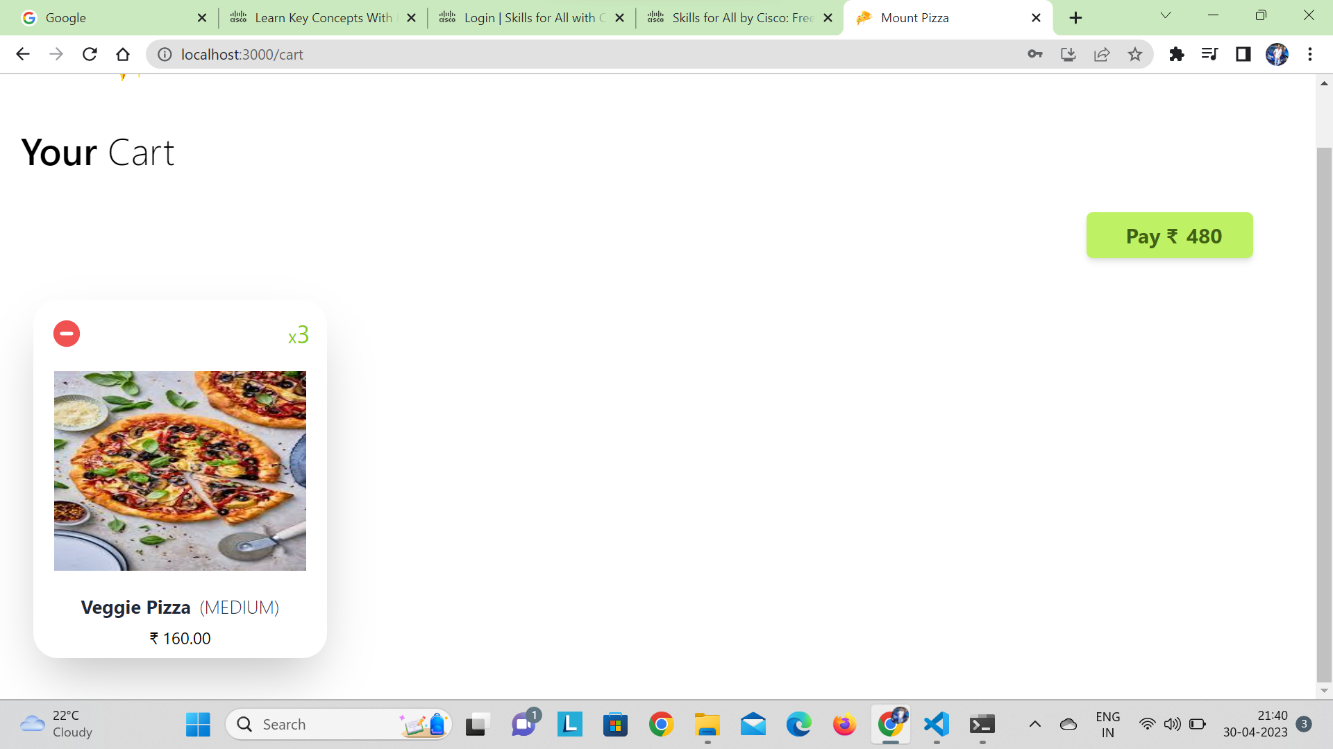

Slide 10
4. Build Your Pizza:
The customer will get an option to select the pizza crust’s size which will be small, medium and large.
Then the customer has to choose the sauce to be used on his pizza crust. These can be marinara cheese, ranch and others.
At last the system shows the customers different types of toppings.

Slide 11
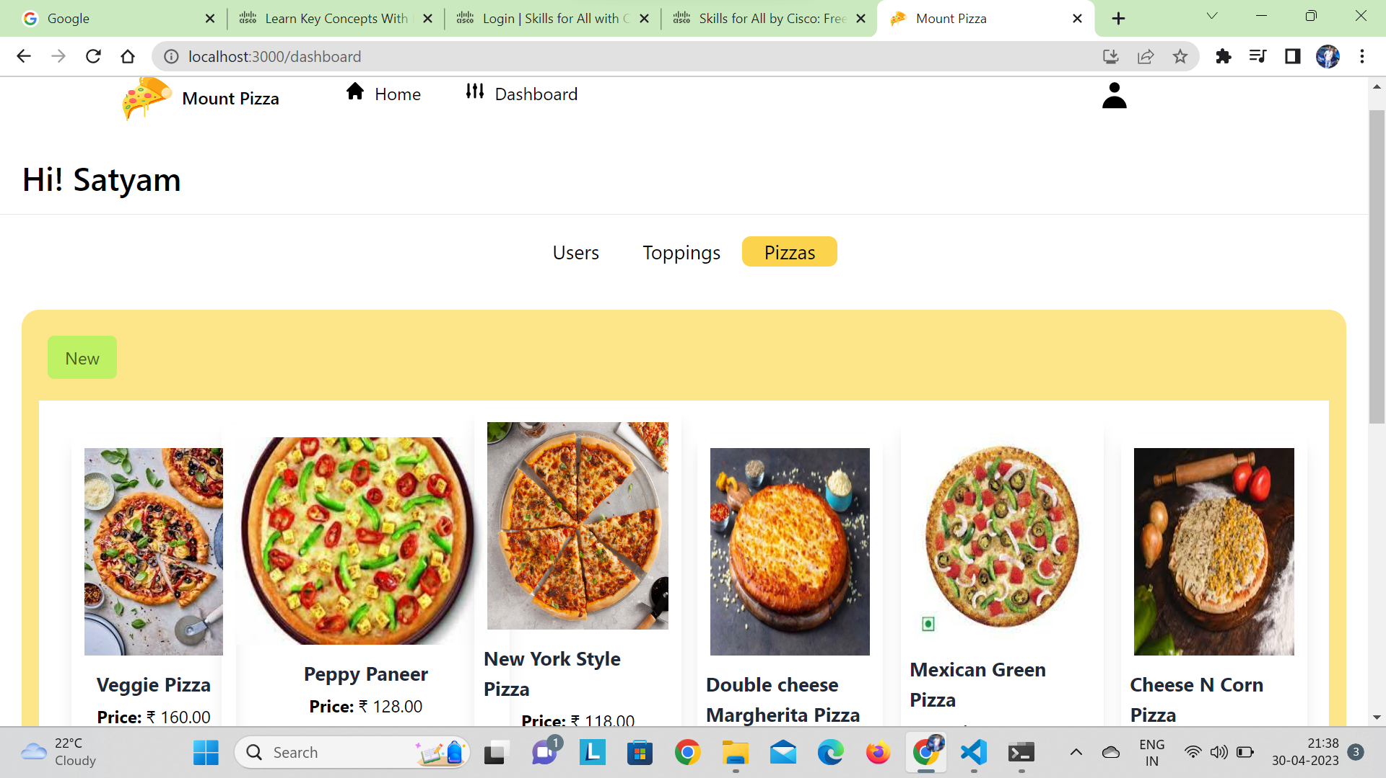

Slide 12
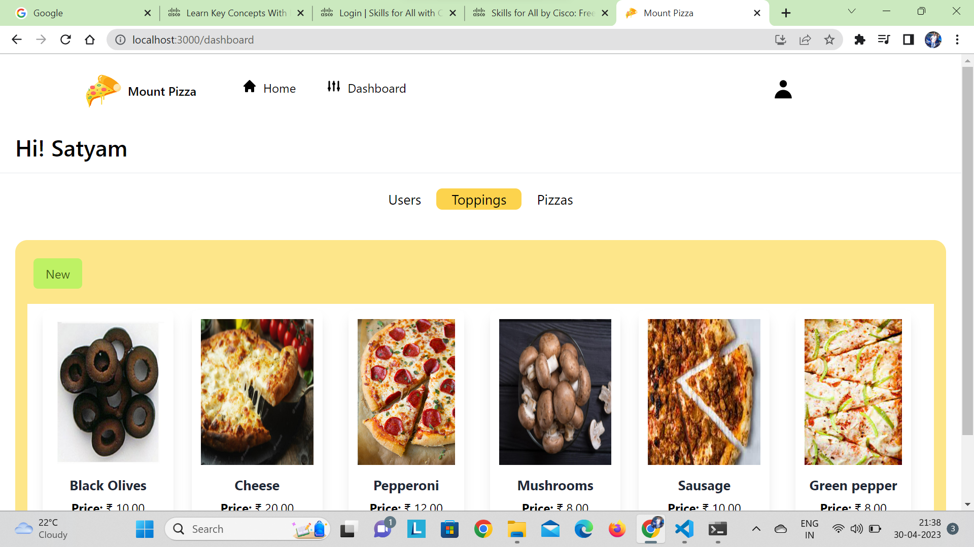

Slide 13
5. Administration:
Admin can add/edit/delete different ingredients into the system.
He can add/edit/delete new pizzas, their images, prices, and other details.
He can add/edit/delete users in this system. It’s the admin who adds new employees’ accounts to the system.
Admin has rights to add/edit/delete orders for customers.

Slide 15
6. Payment Module:
Payment module provide an interactive interface and integration to website so user can pay online and all the access of the transaction control by admin.

Slide 16
PROJECT OUTCOME
User can order his/her their desirable type of pizza on mobile phone or computer system. User can customize his/her pizza and add toppings according to his/her need from the available materials.
Admin can also customize pizzas of specific type and create new pizzas. User can pay for order in deferent payment modes which are cash on delivery , debit card ,UPI.

Slide 17
THANK YOU!!

